Slide 1
Performing exploratory data analysis ,Feature engineering and Predictive modeling.

Slide 2
Title Slide:
Title: Performing Exploratory Data Analysis, Feature Engineering, and Predictive Modeling
Your Name
Date
Slide 1: Introduction
Brief overview of the presentation.
Slide 2: Exploratory Data Analysis (EDA)
Title: Exploratory Data Analysis Definition and importance of EDA. Key EDA tasks: Data visualization Data summary statistics Data cleaning Example EDA visualizations.

Slide 3
Slide 3: Data Visualization
Title: Data Visualization in EDA Types of EDA plots: Scatter plots Histograms Box plots Heatmaps Benefits of data visualization.
Slide 4: Data Summary Statistics
Title: Summary Statistics in EDA Mean, median, and mode Variance and standard deviation Skewness and kurtosis Correlation coefficients

Slide 4
Slide 5: Data Cleaning
Title: Data Cleaning in EDA
Handling missing data
Outlier detection and treatment
Data transformation (e.g., scaling)
Slide 6: Feature Engineering
Title: Feature Engineering Definition and importance of feature engineering. Techniques for creating new features: Feature extraction Feature transformation Feature selection Example feature engineering scenarios.

Slide 5
Slide 7: Feature Extraction
Title: Feature Extraction
Principal Component Analysis (PCA)
Text data vectorization (e.g., TF-IDF)
Time series feature extraction (e.g., lag features)
Slide 8: Feature Transformation
Title: Feature Transformation Standardization and normalization Log transformation Binning and discretization

Slide 6
Slide 9: Feature Selection
Title: Feature Selection
Methods for feature selection:
Recursive Feature Elimination (RFE)
Feature importance from tree-based models
Univariate feature selection
Slide 10: Predictive Modeling
Title: Predictive Modeling Introduction to predictive modeling. Steps in building a predictive model: Data splitting Model selection Model training and evaluation Model types (e.g., regression, classification, time series).

Slide 7
Slide 11: Data Splitting
Title: Data Splitting
Importance of training and testing data sets.
Cross-validation techniques.
Slide 12: Model Selection
Title: Model Selection Types of models: Linear regression Decision trees Random forests Neural networks Model selection criteria (e.g., accuracy, F1-score).

Slide 8
Slide 13: Model Training and Evaluation
Title: Model Training and Evaluation
Training the selected model.
Model evaluation metrics:
Mean Absolute Error (MAE)
Mean Squared Error (MSE)
ROC curve (for classification)

Slide 9
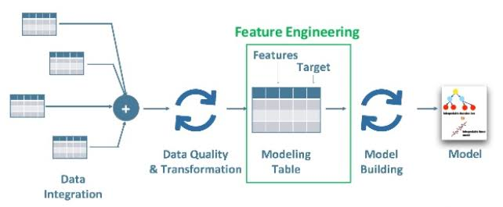

Slide 10
Slide 14: Conclusion
Summarize the key points from each section.
Highlight the importance of EDA, feature engineering, and predictive modeling in extracting insights from data.

